Slide 1
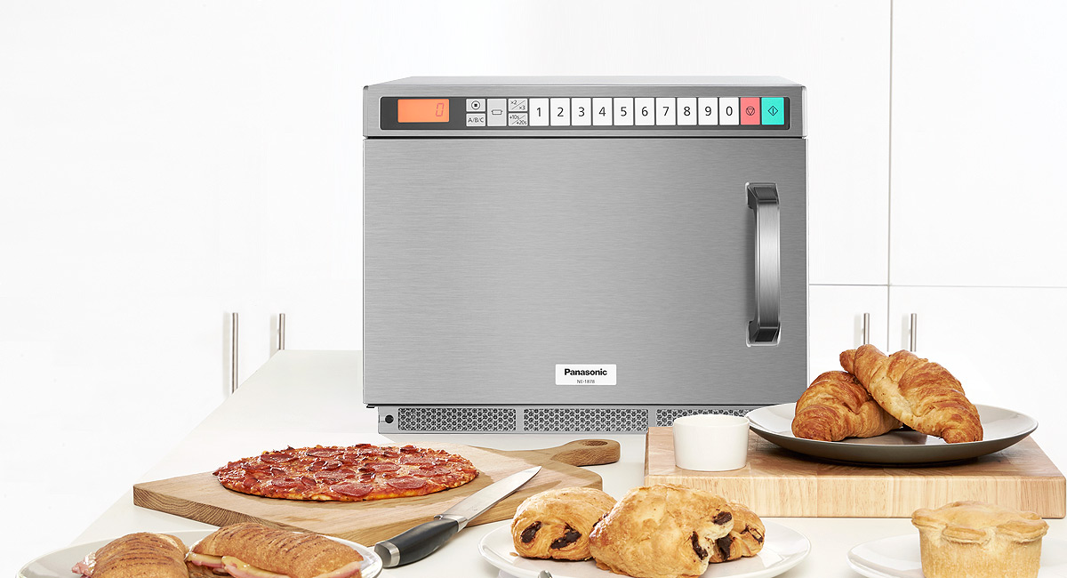
NE-1878BPQ
PROFESSIONAL INVERTER MICROWAVE
Equipped with Panasonic's unique Inverter technology, which enables faster, more even, gentler cooking. It also uses less energy and the all-metal door design ensures easy cleaning, extending the lifespan of the microwave.

Slide 2
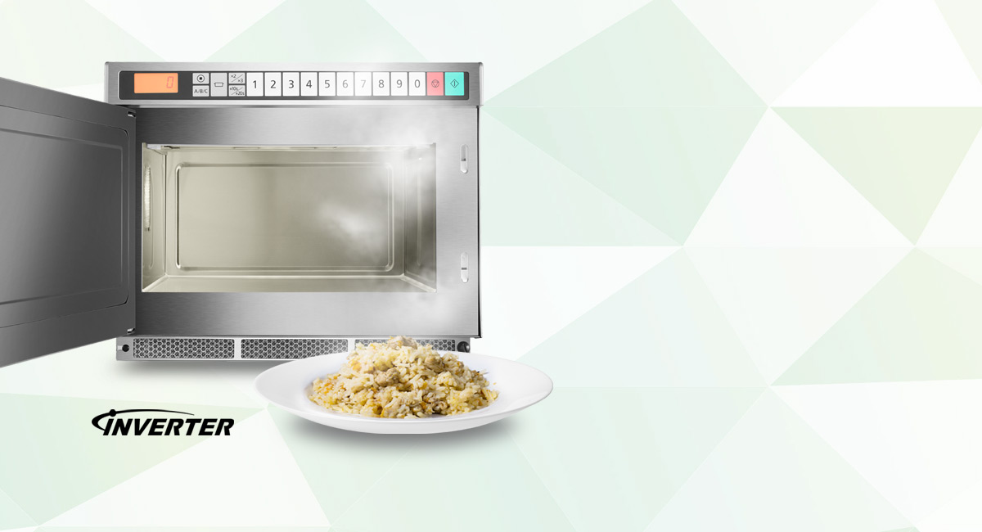
EVEN HEATING
Inverter technology allows you to cook, reheat or defrost your food without creating cold spots or overcooking edges. This Inverter microwave delivers an accurate power level; when you ask for 60% power, the oven delivers 60% power for the entire duration of the cooking time chosen. This applies no matter what power level is selected giving you better, more even cooking results.

Slide 3
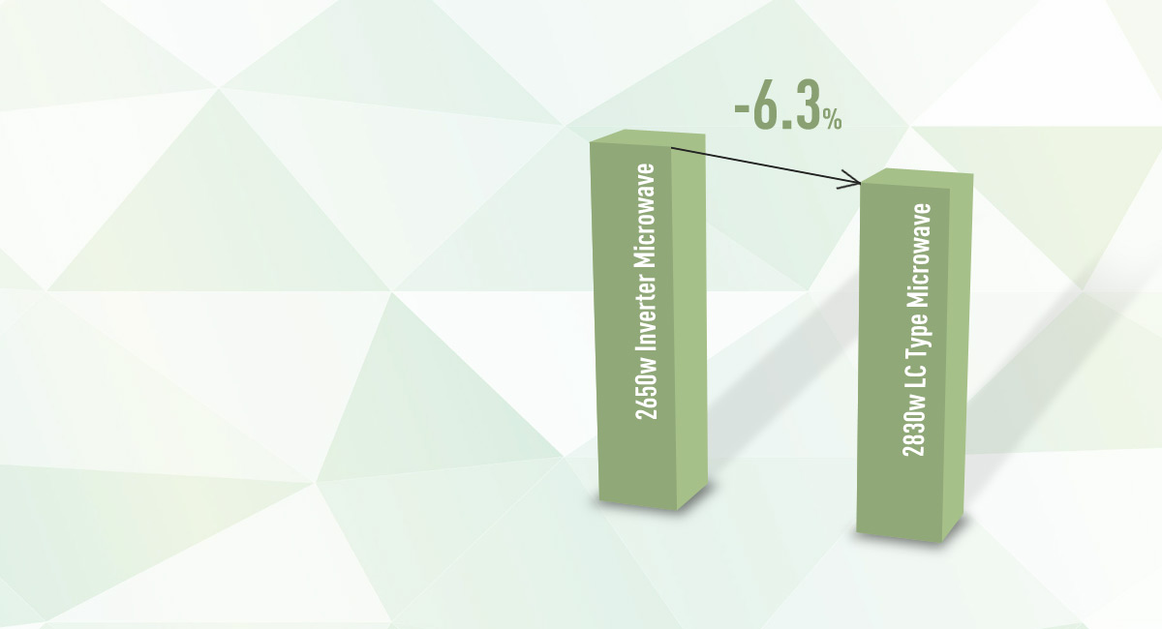
ENERGY SAVING
With Inverter microwaves, you can save up to 6.3% on energy consumption*, which is good for the environment, and your wallet. * Compared to NE-1853 (2650W Inverter microwave compared to 2830W LC type microwave).

Slide 4
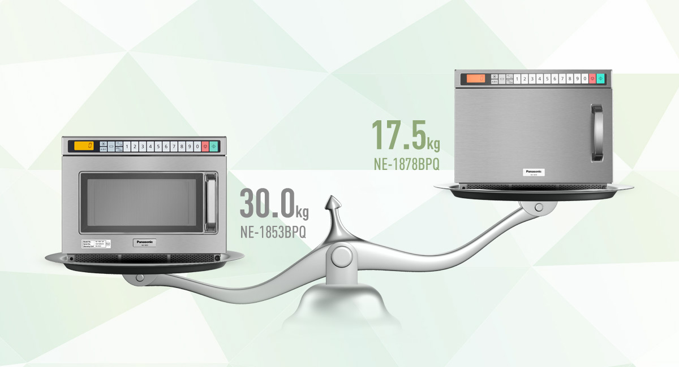
LIGHTER & SMALLER
Inverter microwaves are equipped with a compact and efficient power supply that weights only 500g. This makes the overall unit lighter, more portable and easier to move around for cleaning, as the total unit weight is brought down to approx. 12kg (40% less compared to NE-1853).

Slide 5
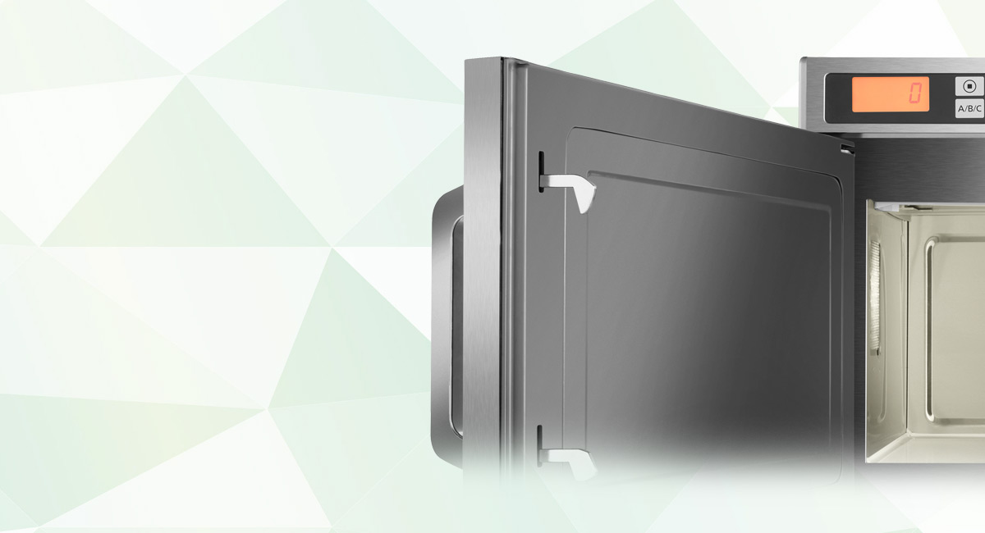
METAL DOOR DESIGN
The world’s first all-metal door professional microwave with Inverter technology. An innovative design, specifically intended for the UK market. A full-metal door microwave that looks like a conventional oven. It adapts to every environment and you can even install it in your open kitchen. Most importantly the inside of the metal door has no ridges, seals or film to clean around, it’s totally smooth. This makes the inside of the unit very easy to clean and increases the lifespan of the oven.

Slide 6
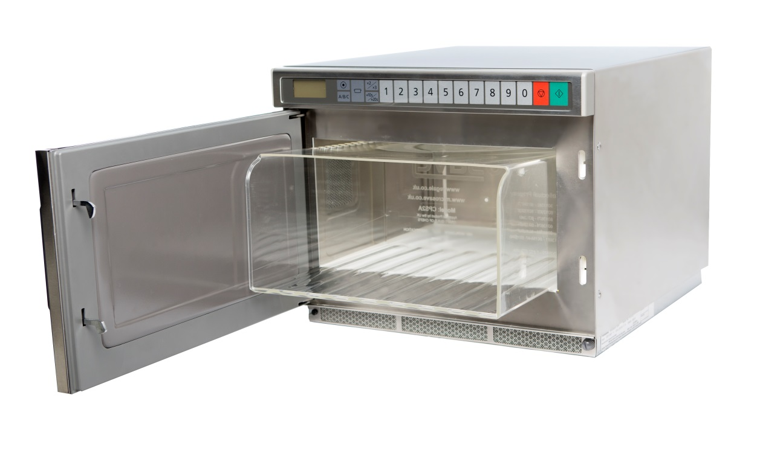
SPLATTER SHIELD DETECTION
The NE-1878 has been programmed to not operate when the ceiling plate is not in place.
Also available from Regale is the Panasonic authorized Microsave CPS3A Cavity Liner. The Cavity Liner protects the microwave’s interior base, ceiling plate and the lens light cover and is dishwasher safe, making cleaning at the end of service, a breeze.

Slide 7
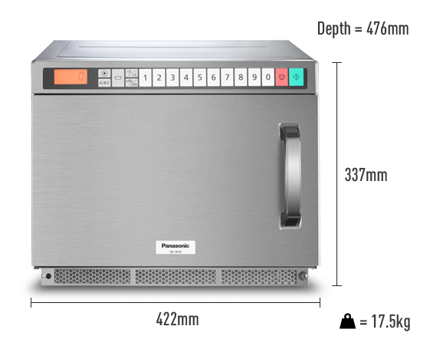
Space Saving Design
Stackable unit
Inverter Technology
Faster, more even & gentler cooking
Metal Door Design
Elegant, durable & easy maintenance door

